Slide 1
Routing distances
The lecture 12

Slide 2
Metric

Slide 3
Metric

Slide 4
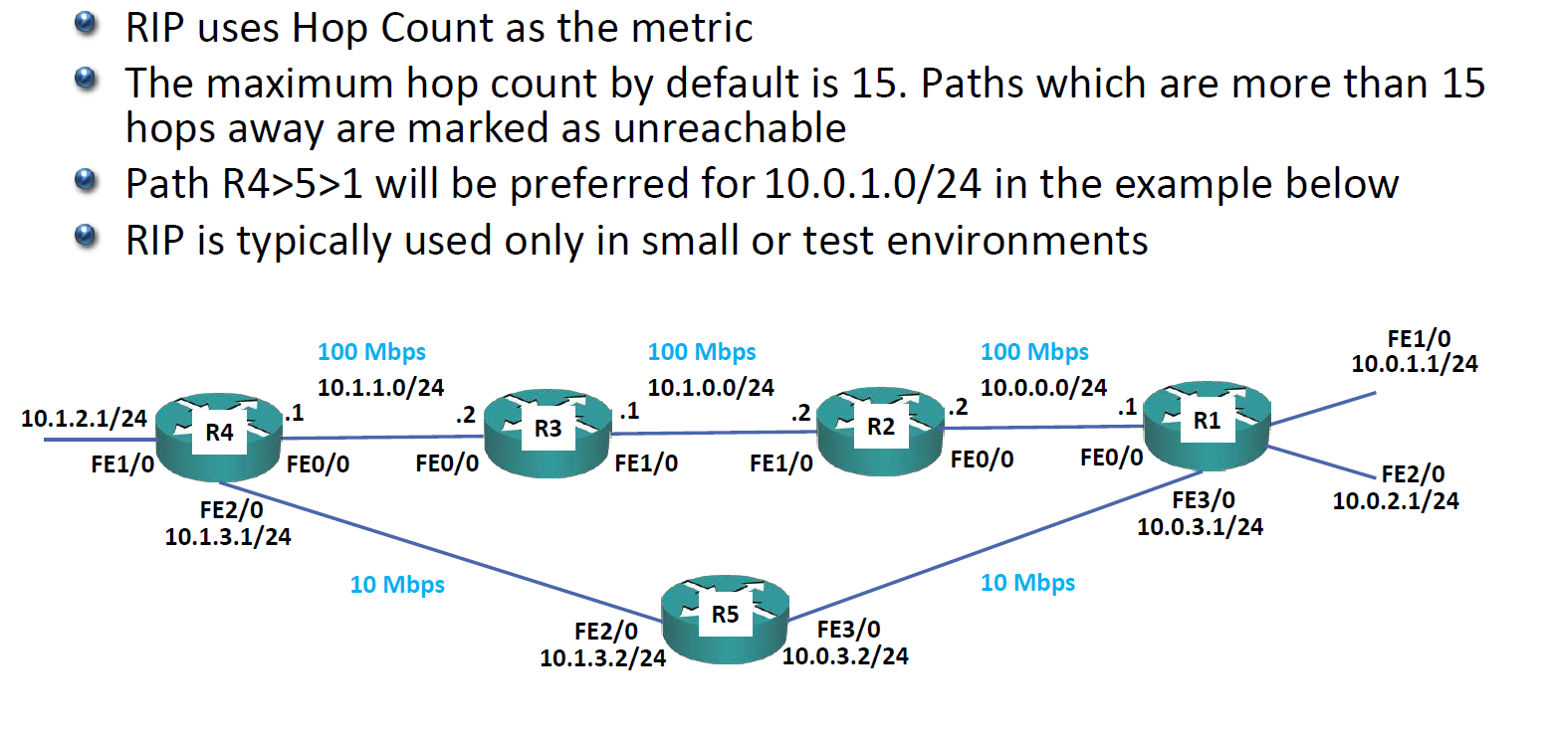
RIP Metric – Hop Count

Slide 5
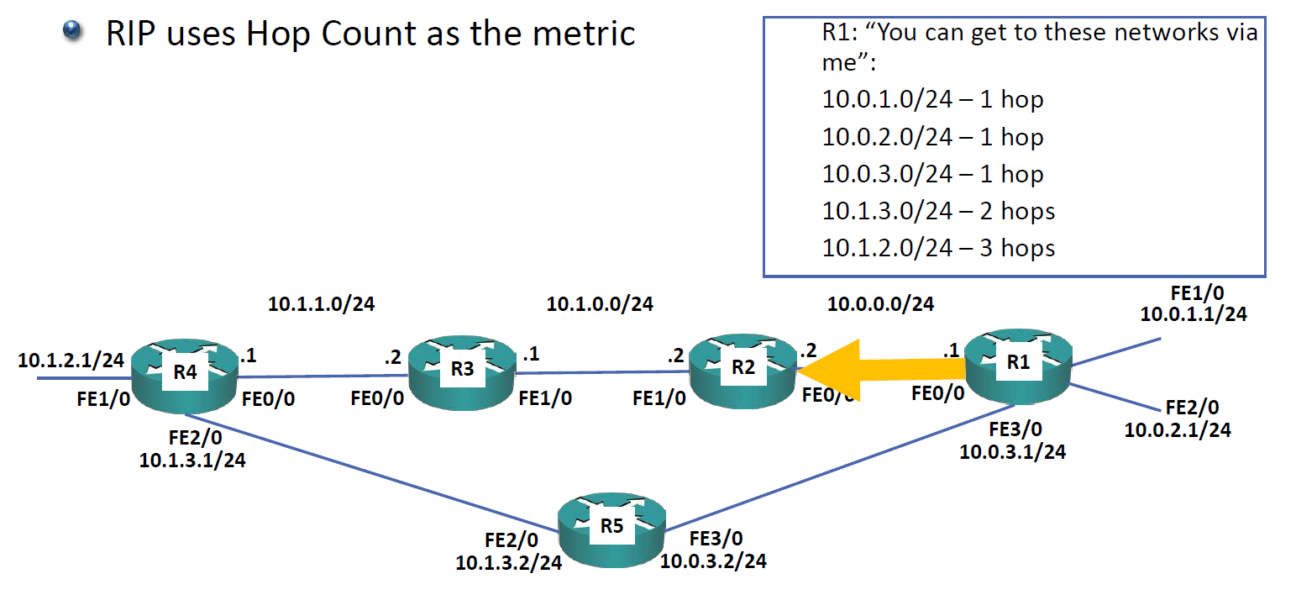
RIP Metric – Hop Count

Slide 6
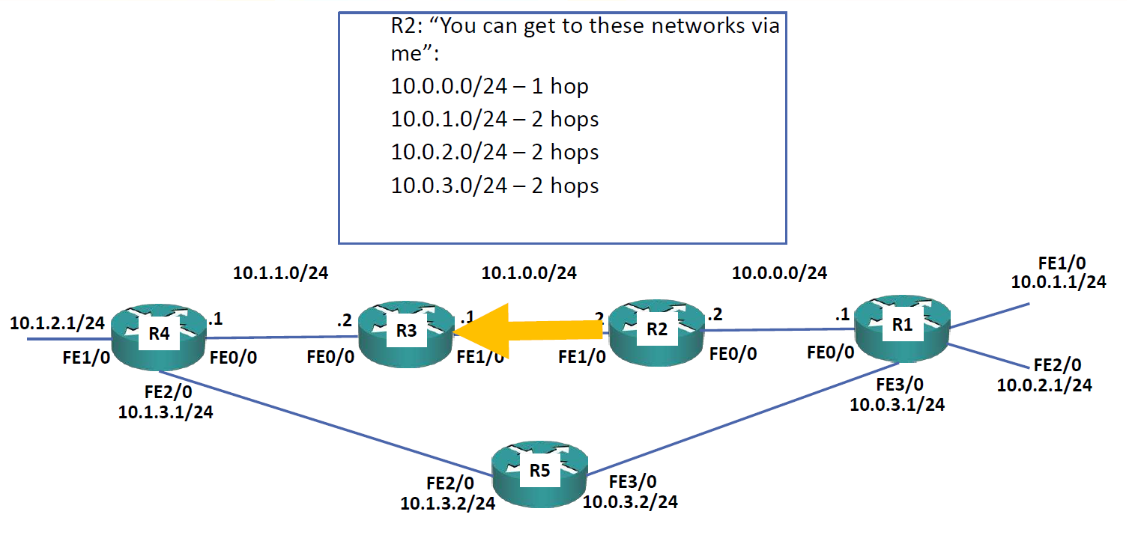
RIP Metric – Hop Count

Slide 7
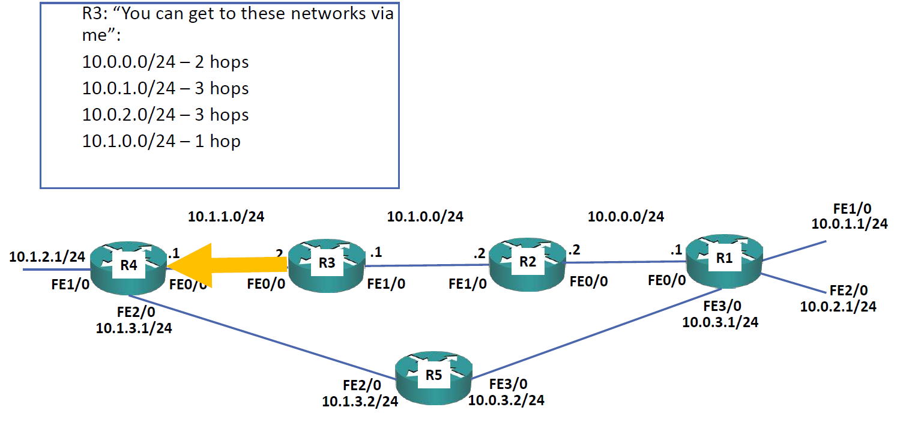
RIP Metric – Hop Count

Slide 8
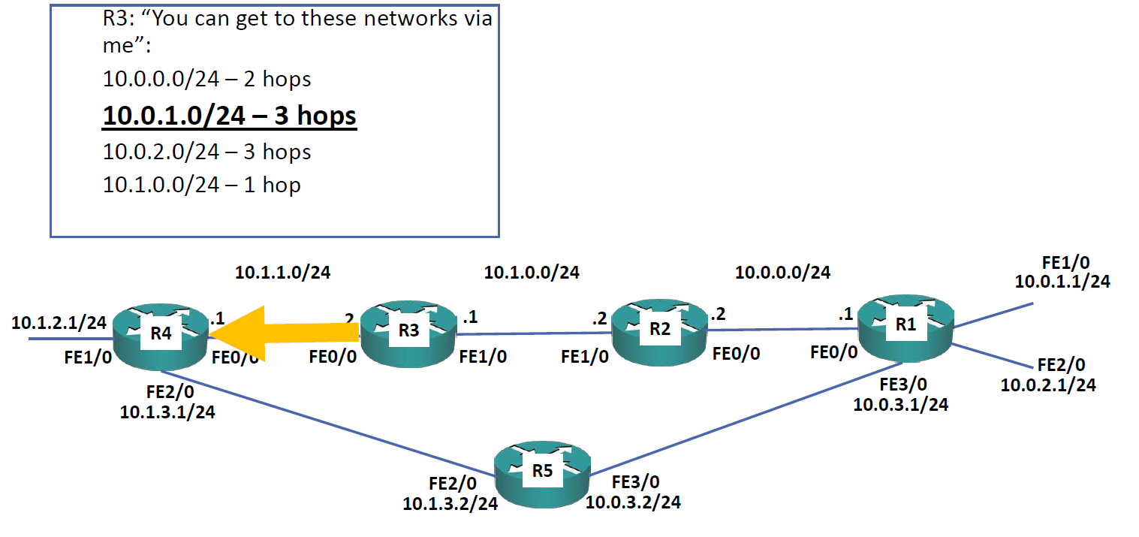
RIP Metric – Hop Count

Slide 9
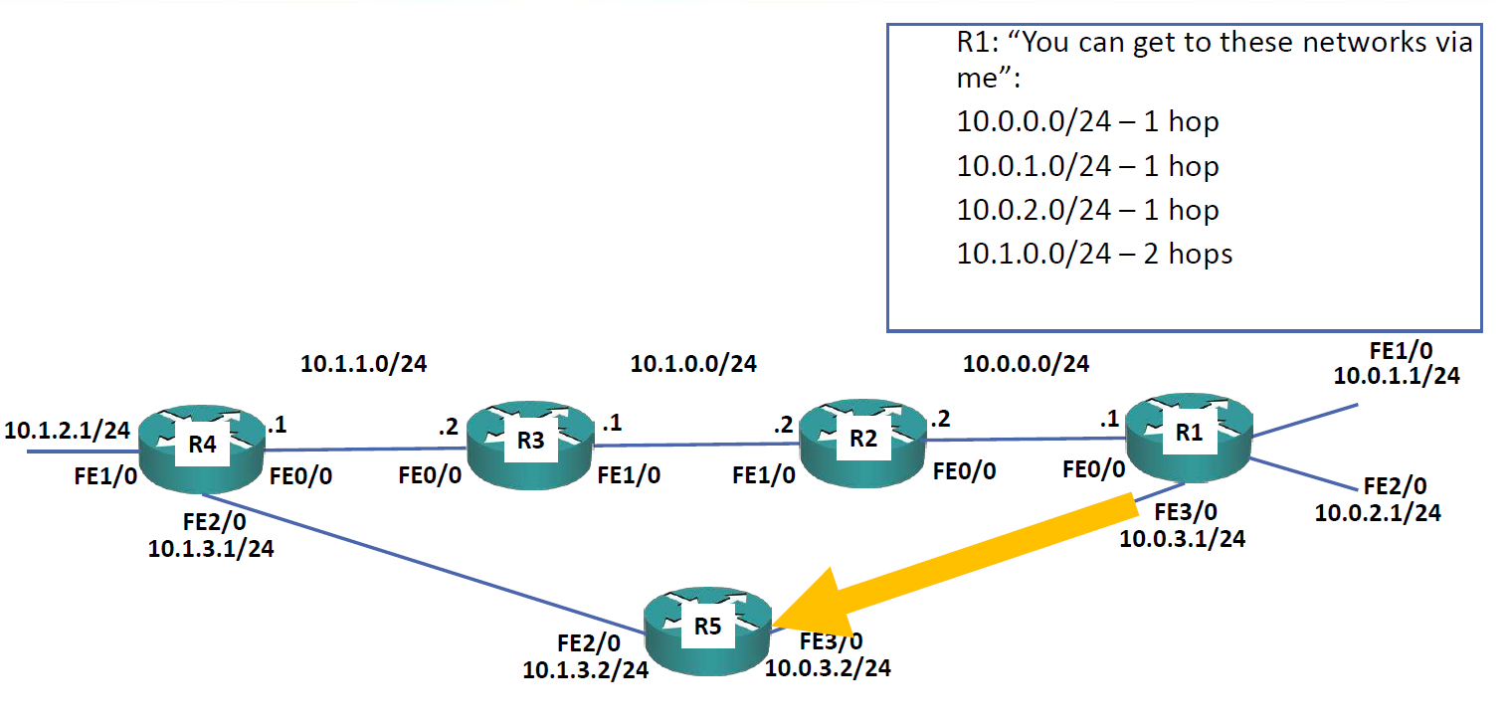
RIP Metric – Hop Count

Slide 10
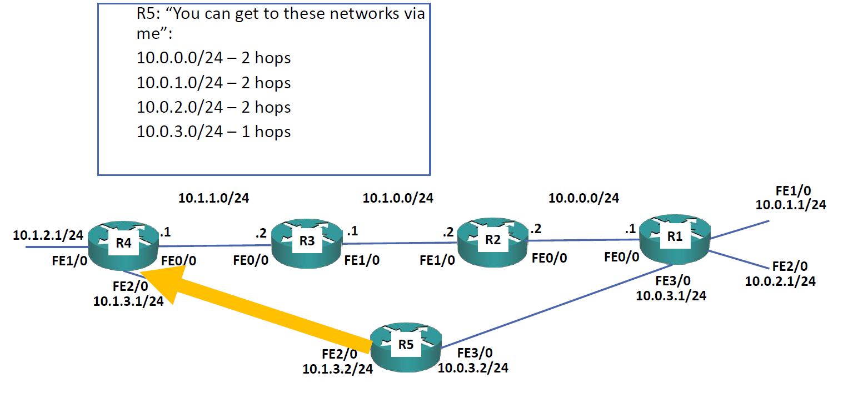
RIP Metric – Hop Count

Slide 11
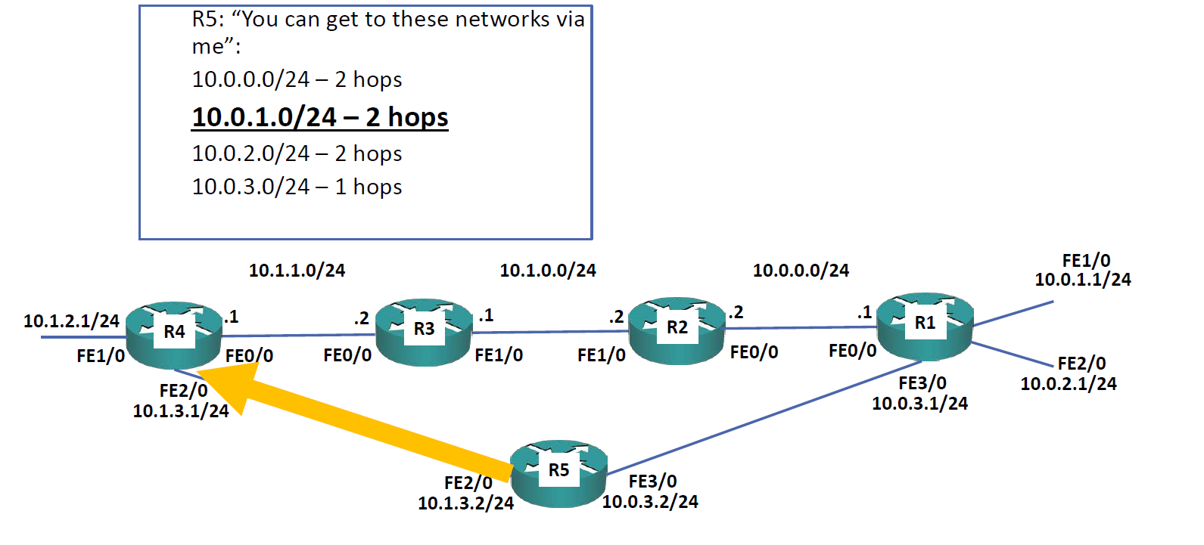
RIP Metric – Hop Count

Slide 12
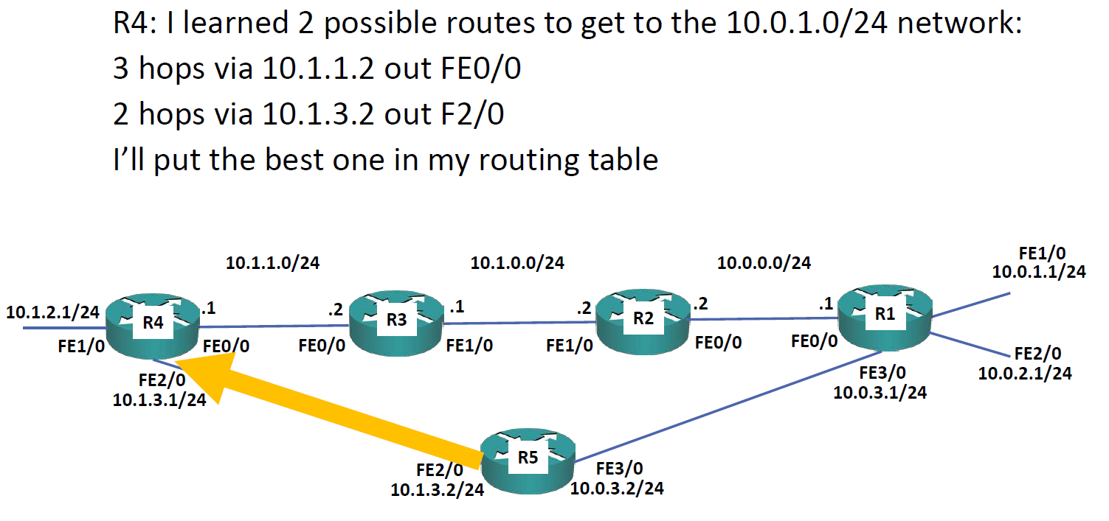
RIP Metric – Hop Count

Slide 13
RIP Metric – Hop Count

Slide 14
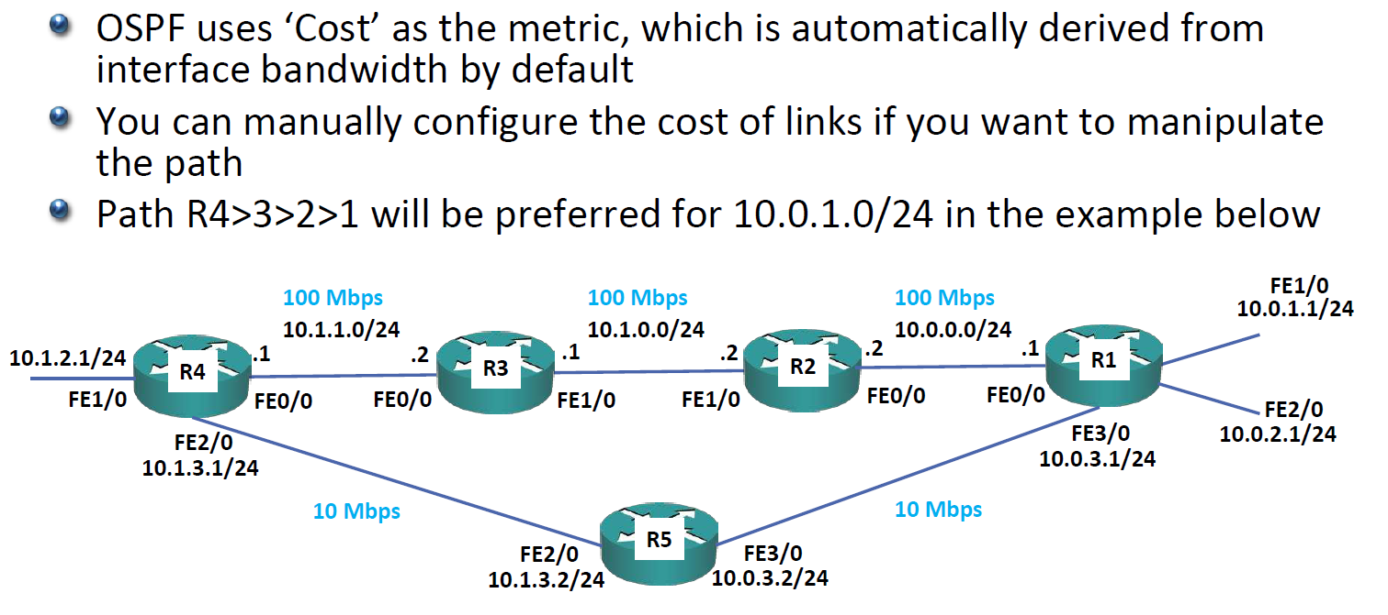
OSPF Metric – Cost

Slide 15
OSPF Metric – Cost

Slide 16
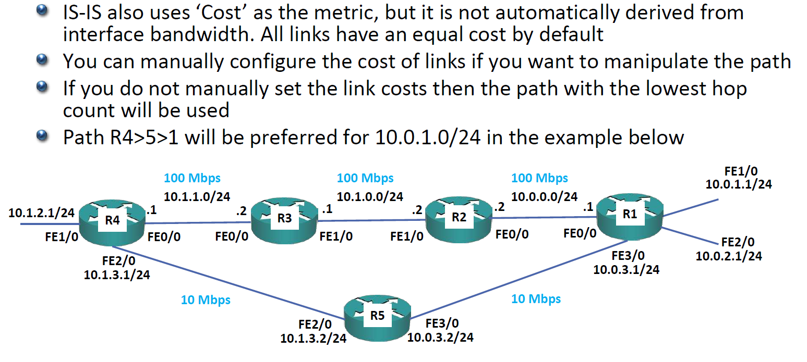
IS-IS Metric – Cost

Slide 17
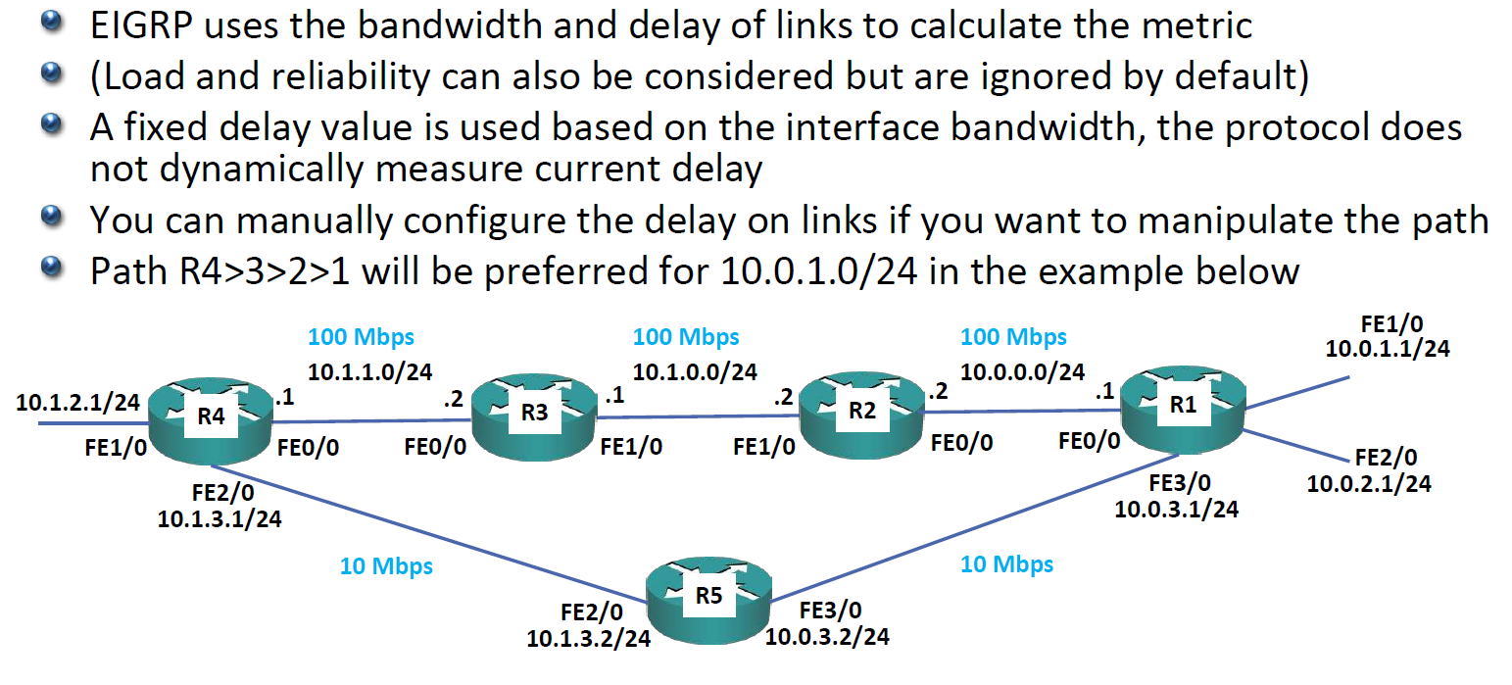
EIGRP Metric

Slide 18
Choosing a Routing Protocol

Slide 19
Equal Cost Multi Path (ECMP)

Slide 20
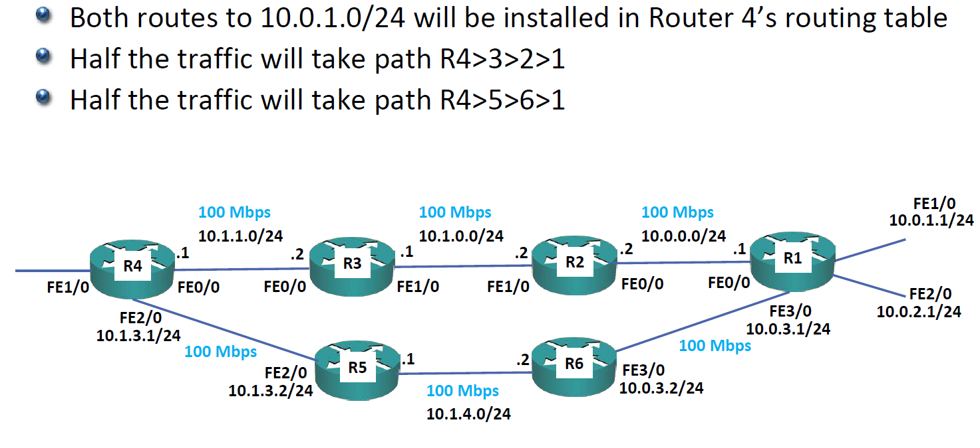
Equal Cost Multi Path

Slide 21
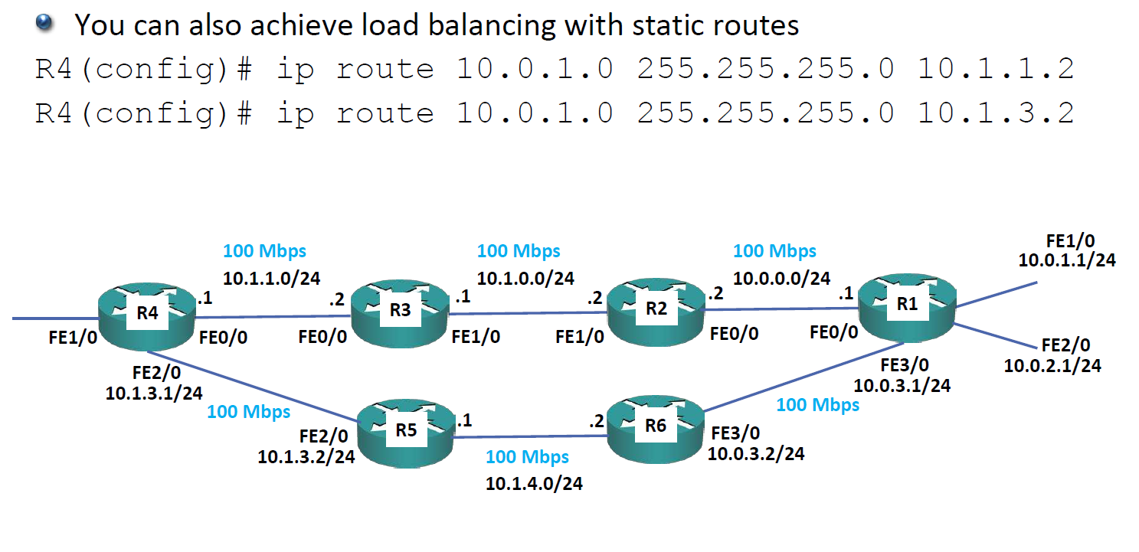
Equal Cost Multi Path

Slide 22
Metric

Slide 23
Metric

Slide 24
Administrative Distance

Slide 25
Administrative Distance

Slide 26
Default Administrative Distance

Slide 27
Administrative Distance and Metric

Slide 28
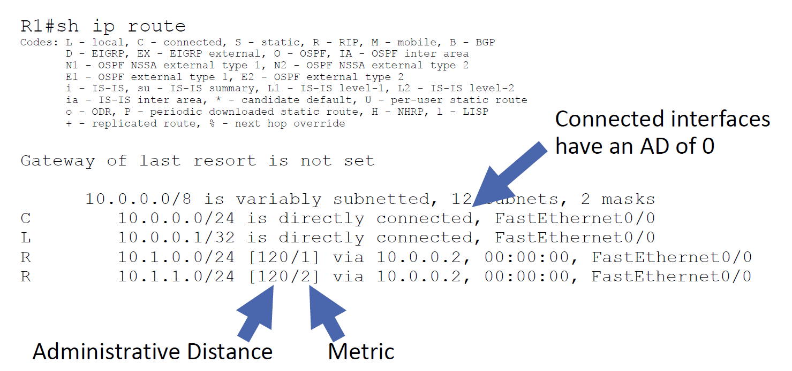
Show ip route

Slide 29
Administrative Distance Example

Slide 30
Administrative Distance Example

Slide 31
Floating Static Routes

Slide 32
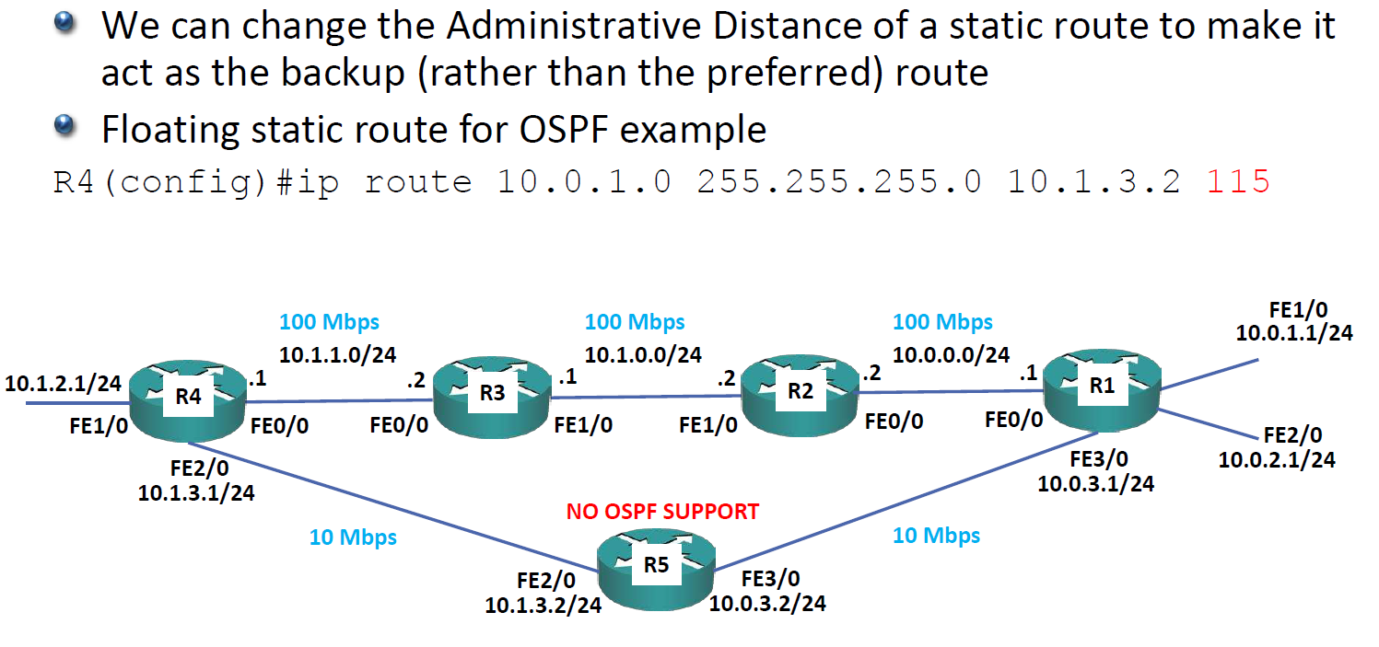
Floating Static Routes – OSPF

Slide 33
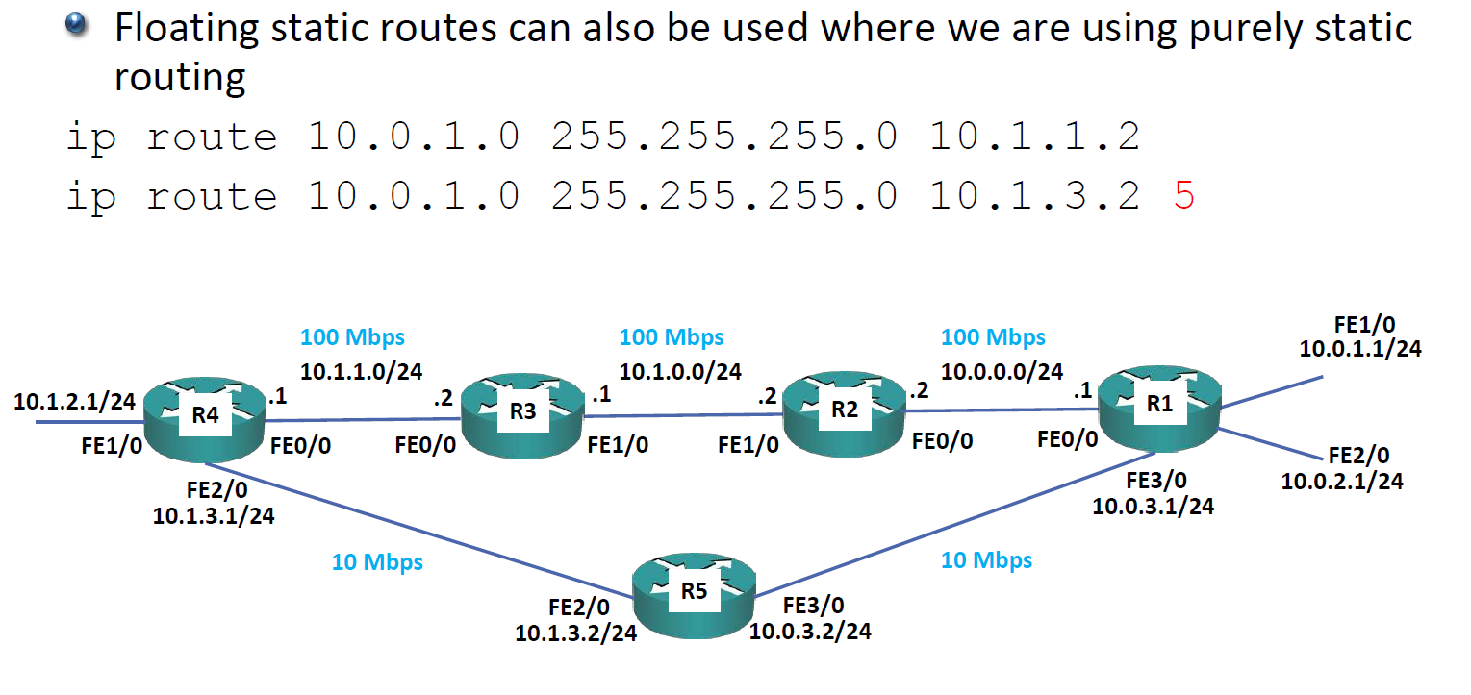
Floating Static Routes – Static Routes

